Slide 1

AI in the Classroom
Session 1: 21/05/25
As You Arrive:
Open the document that we shared with you before the session
Log into TeachMateAI and ChatGPT

Slide 2
Structure of the Session
What is AI? Why use it?
TeachMateAI vs ChatGPT - what’s the difference?
Lesson Planning
Exemplars/Model Answers
Report Writing
Q&A
Future plans

Slide 3
What is Generative AI?
Generative AI is a specific kind of artificial intelligence — one that focuses on creating new things, like text, images, music and more.
You probably already interact with other forms of AI in your daily life, even if you don’t realise it. For example:
Google Maps or Waze to plan your commute
Siri or Alexa to understand your voice and respond with useful information
Netflix, Amazon or Spotify to analyse your habits and predict what you might like next.
These types of AI are good at recognising patterns and predicting outcomes. Generative AI goes a step further — it uses those patterns and predictions to create.

Slide 4
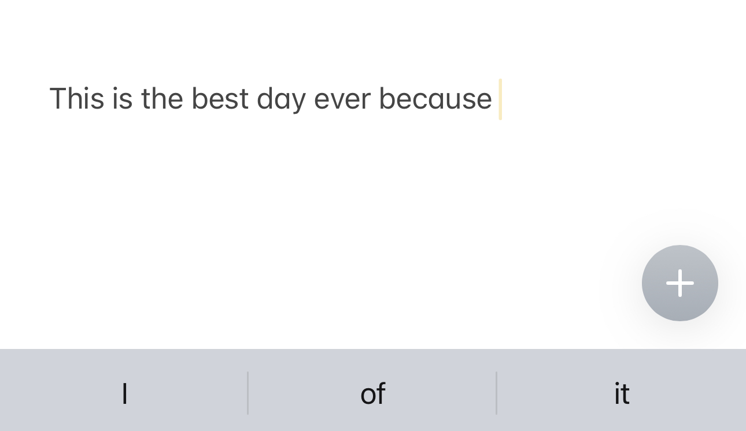

What is Generative AI?

Slide 5
Why Should Teachers Be Using AI?
It saves time
  It speeds up repetitive tasks
It reduces mental load
It helps with differentiation and adaptive teaching
It supports communication with parents and the general public
It can help analyse data
It can spark creativity and offer perspectives you might not have considered
It can summarise lengthy documents
Our students are already using it
Teacher cognitive load

Slide 6
from The EdTech Podcast #278: AI as a Tool for Equity of Learning
“Look, if we do AI right, at the end of the day, there will be teacher fingerprints all over it. And if we do it wrong, we will be sitting there going, "Man, I wish we had teachers more involved."”

Slide 7
TeachMateAI vs ChatGPT – What’s the Difference?
TeachMateAI is basically a ‘wrapper’ for ChatGPT. They both draw on the same data. TeachMateAI just filters what is returned to you by structuring most of the prompt for you. You just fill in the blanks – like a cloze activity.
Please generate a full lesson plan using the following information. This lesson is based on the ____________________________ curriculum. It is designed for students in year ____________________________. The subject of the lesson is ____________________________.

Slide 8
What We Don't Want to Lose When Using Al
• Confidence in making pedagogical decisions grounded in subject knowledge, pedagogical research and experience.
• A strong understanding of why certain tasks, questions, or strategies are used
• The skill and art of teaching in a live classroom
• Ownership of the whole process - knowing that Al is a tool, not the teacher

Slide 9
Lesson Planning
• Saves time by generating ideas to feed to drafts of plans, WALTs, WILFs, and resources
• Supports adaptive teaching with tailored scaffolds, challenges, and prompts
• Enhances lesson structure using research-based frameworks like Rosenshine, Bloom's taxonomy and more.
• Adapts content quickly to suit new topics, classes, curriculum changes and abilities.
• I hadn’t thought of that!

Slide 10
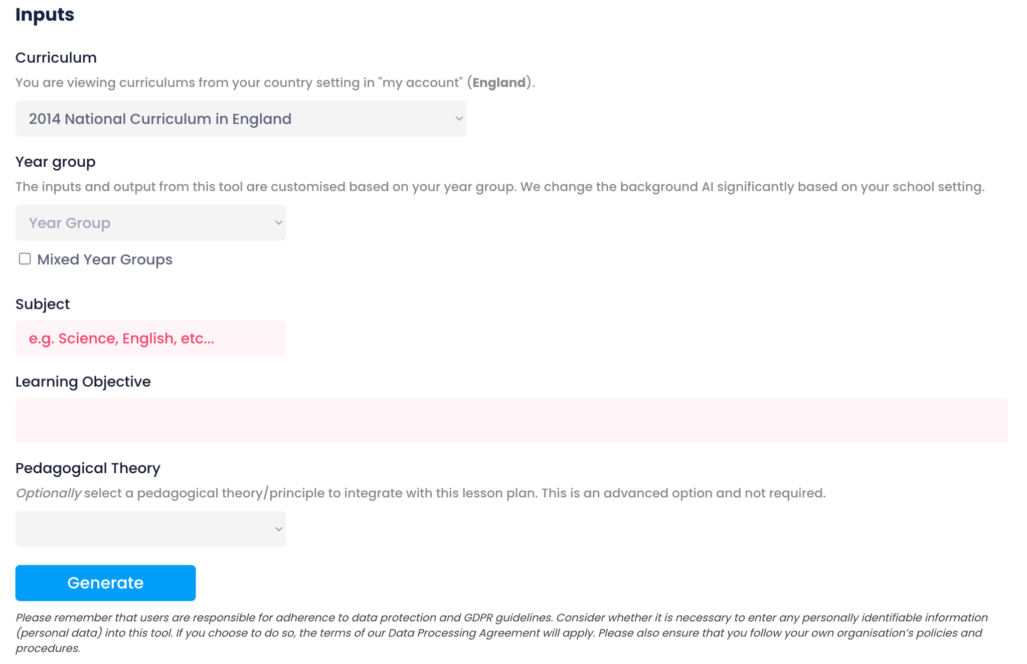

Slide 11
Assessment in Music using AI
I'm using this example to demonstrate how ChatGPT can support teaching, specifically in curriculum planning and assessment design.
In this case, I used AI to generate assessment criteria for a composition project I'm running with Year 7. The project is based on Ralph Vaughan Williams’ The Lark Ascending. Each week, students were introduced to different musical elements, gradually building the skills and ideas needed to create their own compositions.
This image shows the final slide students used to guide their final piece. I uploaded this into ChatGPT and asked it to create a structured assessment sheet based on the taught content — and it produced a detailed, mark-based rubric aligned with my objectives.

Slide 12
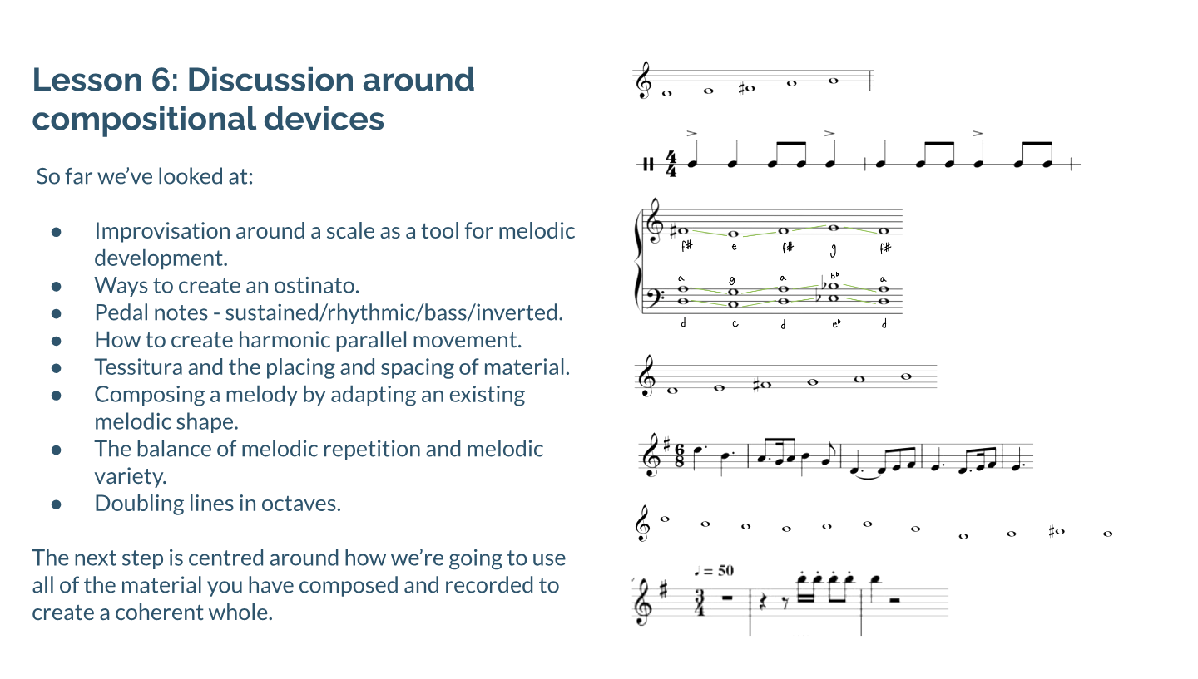

Slide 13
This is what AI came up with:
I then asked AI to create a spreadsheet where it adds up the totals automatically for me:
This is now a reusable document I can use every time I teach this project - and it took me less than five minutes to create. (Admittedly, a little longer because I spent some time formatting it to look nice!)
Year 7 RVW - The Lark Ascending
Year 7 RVW - The Lark Ascending

Slide 15
Exemplar and Model Answer Generation
• Saves time creating high-quality examples
• Supports modelling during lessons with editable, targeted examples
• Improves access by generating simplified or scaffolded versions for different learners
• Teachers can do this, but it definitely saves loads of time

Slide 16
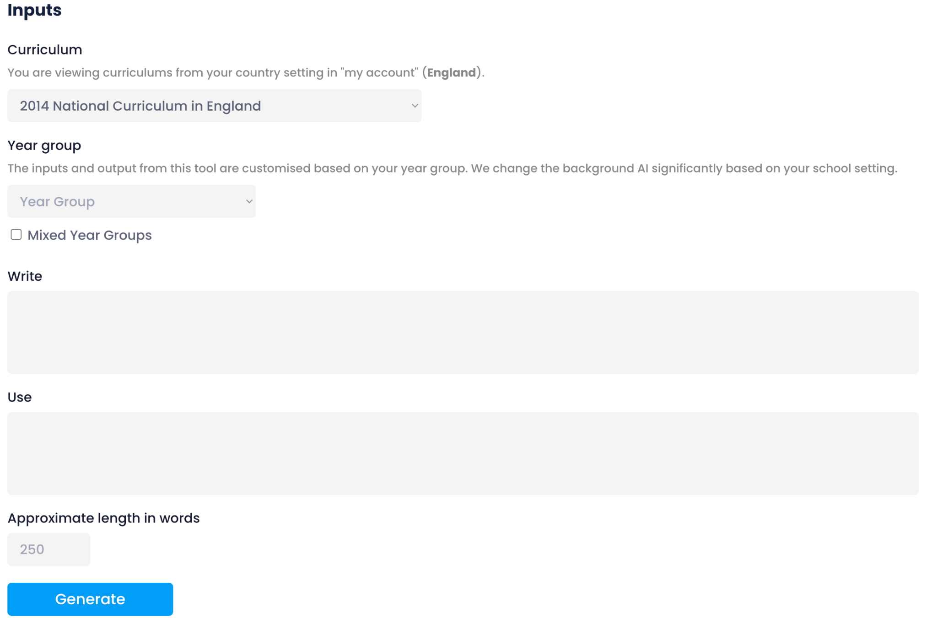
Exemplar and Model Answer Generation

Slide 17
Exemplar and Model Answer Generation
Possible uses already in place
Writing - Model texts for ability
  Specific grammatical features
  Content linked to other literature
  Personalisation
All subject - Daily handwriting practice
  link to previous learning in subjects
  interleaving and retrieval practice over time in context
Maths - retrieval tasks with high volume of questions using variation theory
SEND - Personalisation of resources - social stories, visual prompts, overlearning resources, Audio versions of text or instructions, Targeted comprehension questions

Slide 18
9 point questions for GCSE Listening Exam
One of the areas many students find particularly challenging in the GCSE Music exam is the 9-mark extended response question. In this task, students must listen to an unfamiliar extract and write about how the Elements of Music are used to reflect context, character, or mood — all in prose. This is a skill that is both unfamiliar and demanding, especially when done under timed exam conditions.
While regular practice is key to developing this skill, the time required to select listening extracts, plan questions, and model structured responses can be difficult to build into lessons consistently. To support this, I’ve begun using AI to generate sample questions, model answers, and differentiated scaffolds based on the OCR syllabus and assessment criteria, which I’ve already incorporated into the system.
This has allowed me to quickly produce high-quality listening questions and model answers that align with GCSE expectations. Here is an example of the kind of question students are asked in the exam:

Slide 19
Question 3 - 9 points
This question is based on Area of Study 4 – Film Music. You will hear this extract played four times. This is an extract from the film The Call of the Wild and the scene is called Ice Rescue. One of the main characters is a big dog named Buck and in this scene he rescues his mistress from freezing water after she falls through some ice. Using your knowledge of this style write a paragraph, using sentences, explaining how the music conveys the scene. You may wish to refer to instruments, voices, rhythm, melody, texture, tempo or any other features that are relevant to the context of the music.

Slide 20
This is the answer AI came up with from all the criteria I added from the syllabus and the marking scheme from this exam paper - This is a level 9 answer!!
The music effectively captures the drama and emotion of the ice rescue scene. It begins with a timpani hit and roll, combined with a low brass note that gradually gets louder, building tension as Buck sees his mistress fall through the ice. The fast 4/4 tempo, minor key, and use of chromaticism reflect the urgency of the situation. As the action intensifies, violins enter playing semi-quavers in semitones, creating an angular and unstable feel, with pairs of notes adding to the unease. Flutes repeat accented, breathy notes, contributing a harsh and desperate atmosphere. A snare drum rhythm reinforces the sense of movement and panic as Buck runs to the hole.
As the dog jumps into the freezing water, the music softens and becomes smoother. A metallic cymbal sound and rising two-note groups in the strings and flutes, along with higher pitch and the appearance of the harp, suggest the icy, underwater environment. The music is very motivic, with the melody rising while the bass descends, illustrating Buck’s dive and frantic search.
When Buck finds his mistress, the brass play a short descending melody, and voices enter, adding emotional weight. A snare drum roll and crescendo build to a cymbal crash, leading to a dramatic climax with a major chord and a soaring legato violin melody, before returning to minor. The tempo slows, and there is rubato, showing exhaustion and relief. The texture is homophonic and dramatic, with a wide range of pitch and dynamics. As they try to pull her out, the music modulates and rises to a final climax, where the voices return singing a familiar theme, symbolising hope and resolution as they successfully rescue her.

Slide 21
This is the answer AI came up with from all the criteria I added from the syllabus and the marking scheme from this exam paper - This is a level 4-5 answer!!
The music starts with low instruments that get louder to show something bad is about to happen. When the dog sees the woman fall in, the music gets faster and sounds tense. The strings play fast notes and the drums keep a steady rhythm. As the dog jumps in the water, the music becomes softer and uses higher instruments to make it sound cold. Later, the music builds up again and gets louder as the dog finds her. The voices come in and the music becomes emotional. At the end, it slows down and gets dramatic to show they are safe.
This is the answer AI came up with from all the criteria I added from the syllabus and the marking scheme from this exam paper - This is a level 0 -2 answer!!
The music is fast and loud when the dog is running. Then it goes quiet when he jumps in the water. There are instruments playing and then it gets louder again. The music sounds sad and scary. At the end it gets happy. There are drums and some high sounds.

Slide 22
What impressed me most was that AI prompted me to do something I hadn’t even considered — it asked whether I wanted to create example answers at lower assessment boundaries, so students could clearly see the differences in quality and structure between responses. Of course, I said yes!
It also offered to generate a student-friendly version with gaps and prompts to support guided writing practice, which is perfect for scaffolding learning and building confidence.
Within minutes, I had differentiated resources ready to go — tailored to suit all levels of ability in my class.
The real breakthrough is that I can now replicate this format with any piece of music I choose. What would have taken me hours of planning and resource creation is now done in minutes with the help of AI — consistently, accurately, and in full alignment with the OCR specification and mark scheme.

Slide 24
Report writing
Student Name | Anon ID | Merits | Demerits | Adjectives | Clubs Attended
Alice Thompson | Student 1 | 8 | 0 | hardworking, polite | Drama, Netball
Ben Carter | Student 2 | 5 | 2 | curious, energetic | STEM Club
Chloe Ahmed | Student 3 | 10 | 1 | focused, reliable | Choir, Debate
Daniel Smith | Student 4 | 3 | 4 | creative, inconsistent | Art Club
Eva Zhang | Student 5 | 7 | 1 | cheerful, diligent | Basketball, Eco Club

Slide 25
Report writing
Alice is a hardworking and polite student who has made a consistently positive contribution to our tutor group this term. She approaches her studies with maturity and care, as reflected in her excellent record of 8 merits and no demerits — a clear sign of her positive behaviour and commitment to our school values.
Alice is someone who brings a calm and thoughtful presence to the group. She is respectful in her interactions with both peers and staff, and her polite manner helps to create a warm, inclusive atmosphere. Outside of lessons, Alice is a keen member of the Drama and Netball clubs, showing her willingness to get involved in wider school life and her ability to work effectively as part of a team.
It has been a pleasure to see Alice continue to grow in confidence this term. Her consistent effort, kind nature and positive attitude make her a valued member of the group. I encourage her to keep challenging herself, both in and out of the classroom, and I look forward to seeing all that she will achieve next term.

